Slide 1
PIZZA ORDERING APPS
JUNIOR PROJECT DESIGN
COURSE CODE : CSE 299
SUBMITTED TO : Mohammad Monirujjaman Khan

Slide 2
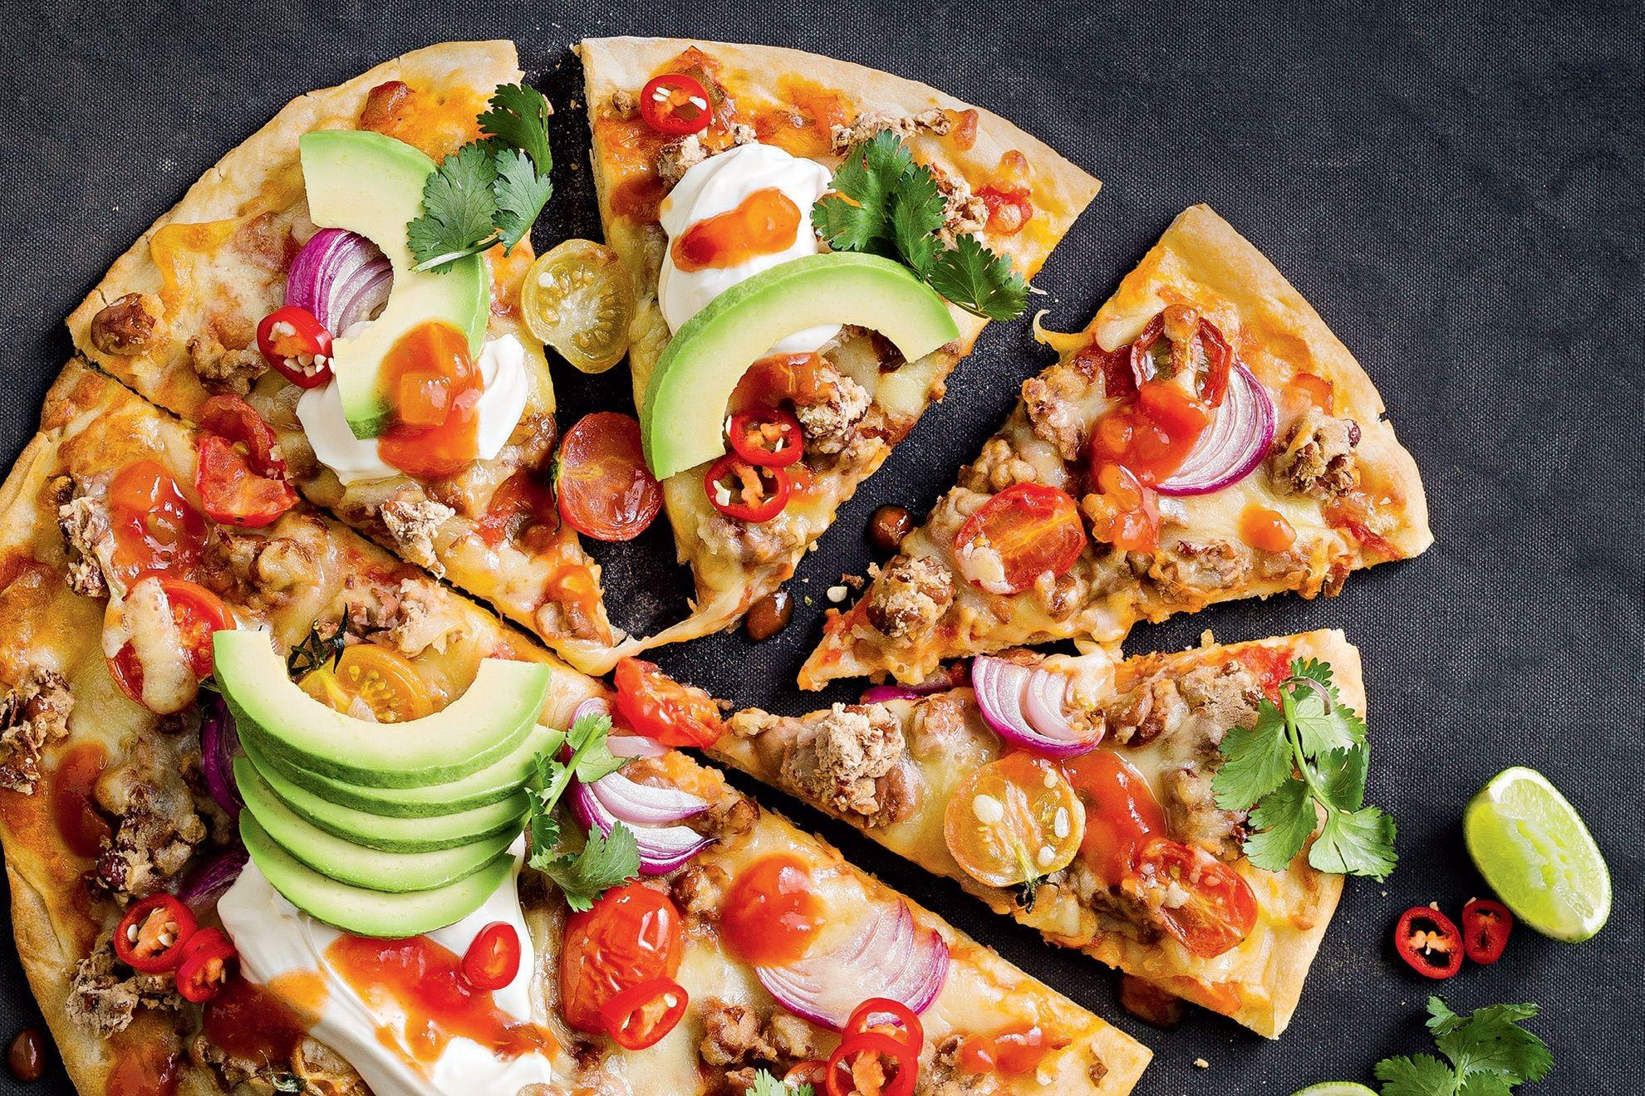

Slide 3
GROUP MEMBERS
Md.Marjan
ID:1621396042
Khan Zuhair Zahin Rafid
ID: 1521114042
Ashikur Rahman
ID: 1521584642

Slide 4
INTRODUCTION
This Pizza Ordering App is based on a concept of making pizza orders and
payments. Here, the user can login, select pizza sets, quantity and proceed
towards payment . Prices will be displayed in BDT currency . This mini
project contains limited features, but the essential ones.

Slide 5
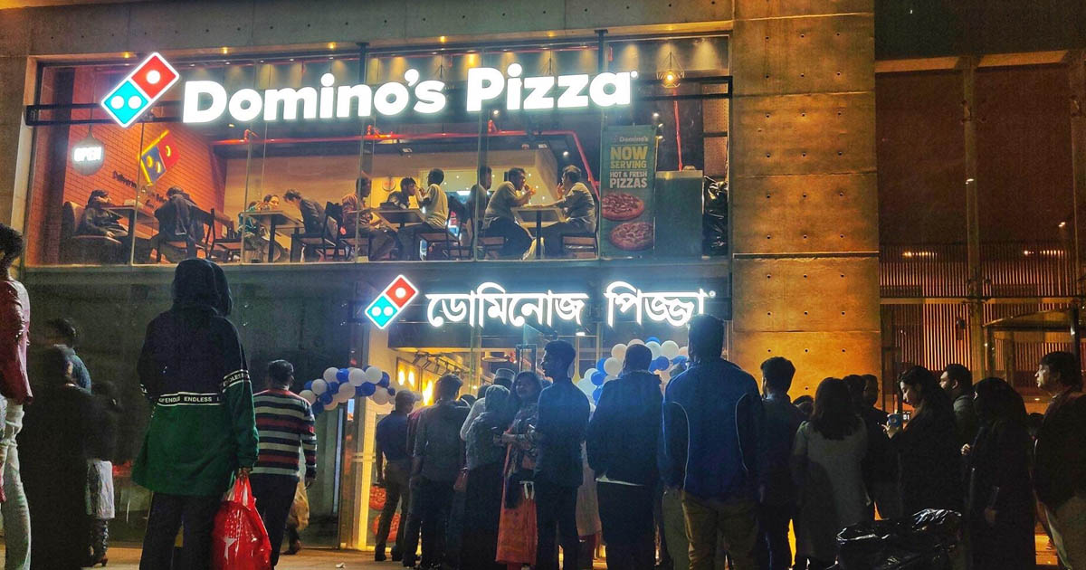
PROBLEMS
For buying a pizza we have to go
to the pizza shop & sometimes it
was full house.
Kills time while ordering a pizza.
Possibilities of faults when we
ordering a pizza by phone call.
Sometimes it takes too much
time to serving a pizza.

Slide 6
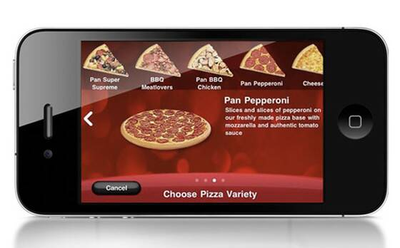
SOLUTION
We develope a android app for ordering a pizza.
Build your own pizza.
Online payment.
Better Knowledge (This system will provide customer all the details of his order before making the order)
Know delivery time.
Reduce paper work.
Improves Efficiency (This system will make things easier for staff as whole ordering process is done by the customer only)

Slide 7
MOTIVATION
- Mobile application is convenient to carry
- Global partnerships and large install base
- Powerful development framework
- Open marketplace for distributing apps

Slide 8
USER JUSTIFICATION
The system will be designed to be user friendly. The user friendly and
interactive interfaces design help to achieve this by enabling customers to
easily browse through the menu and place orders with just a few clicks.
The system will be simple to use.

Slide 9
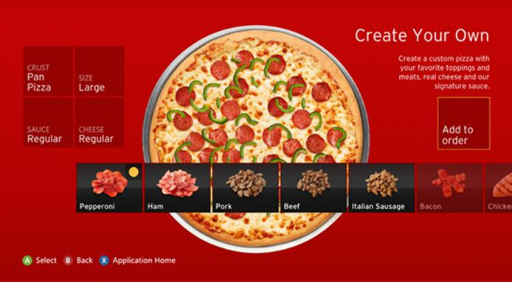

Slide 10
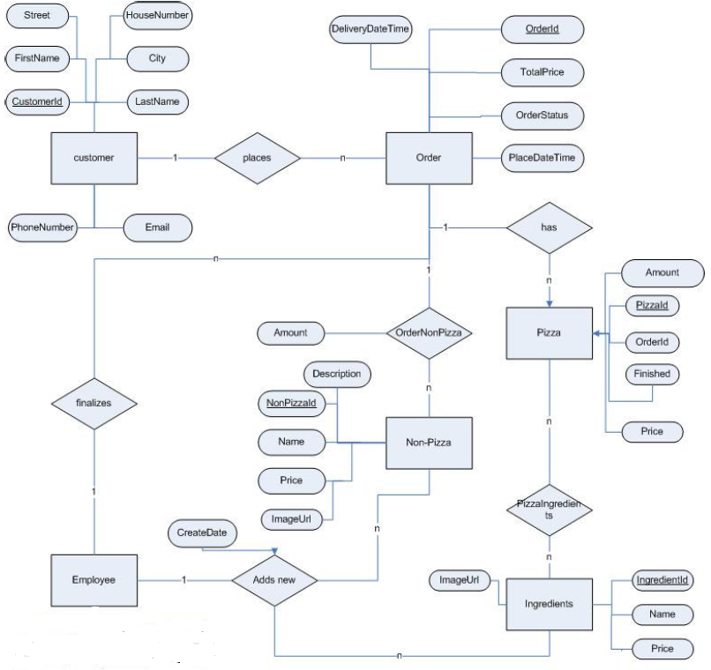
BLOCK DIAGRAM

Slide 11
HARDWARE REQUIREMENTS
Processor: Intel dual core or above
Processor Speed: 1.0GHZ or above
RAM: 1 GB RAM or above
Hard Disk: 20 GB hard disk or above
Mobile: Android phone
USB flash disk (At least 2GB)

Slide 12
SOFTWARE REQUIREMENTS
Operating system: Windows XP / windows 7 and Android
Technology: Java language
Database: Firebase
Java sdk
Android studio

Slide 13
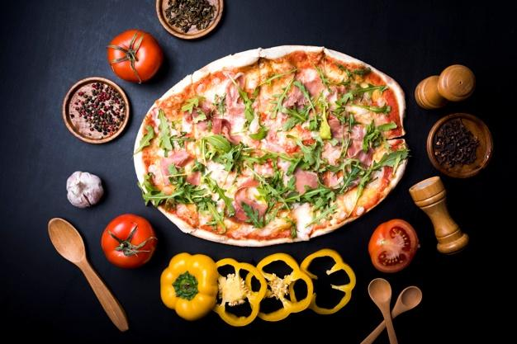

Slide 14
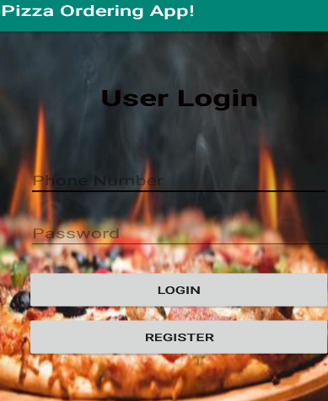
Features
Login
Here, a user can login to the app with his phone number and password. The phone number and password should match with his given and saved information in the registration process. if the number and password do not match then it will show an error message “phone number and password do not match”. If the user does not have an account, then he can register his account by clicking the register button.

Slide 15
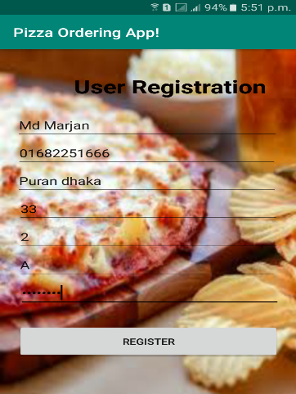
.
Registration
User can register their account here.The user needs to provide his name, phone number, address, house, road, block and password. After clicking the register button,user’s account will be created.If the phone number exists already,then it will show an error message.

Slide 16
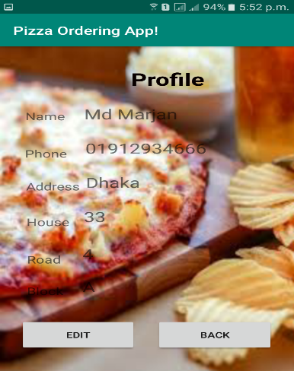
.
View profile
After clicking the view profile button in Home Page, a user can see his profile. Here, all the information of that user will be shown.User can also edit this information by clicking edit profile button.

Slide 17
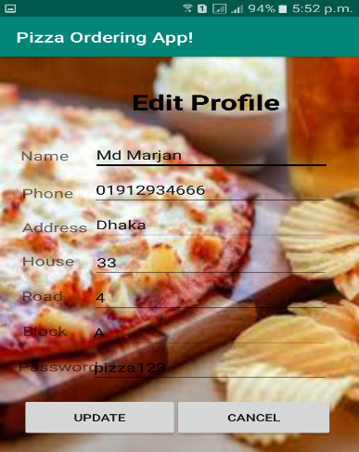
.
Edit Profile
Here, a user can edit all his given information. Initially, all the given information is shown in the text fields. The user just needs to edit those data field by field. Here, the user can also change his password. Clicking the update button, user’s information will be updated.

Slide 18
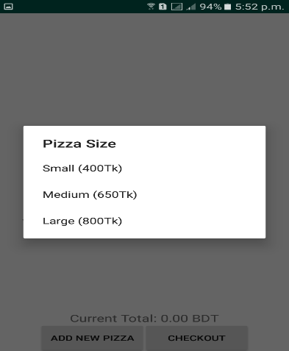
.
Pizza Size Selection
For adding a new pizza, a user needs to select pizza size here. Three pizza sizes with prices are shown in this dialog box. The user must select a size to make progress of adding a new pizza.

Slide 19
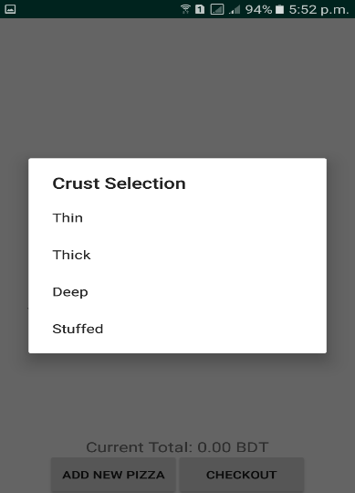
.
Pizza Crust Selection
After selecting the pizza size, here, a user needs to select the pizza crust. Four types of crusts are shown in the dialog box. User must select a type to proceed next.

Slide 20
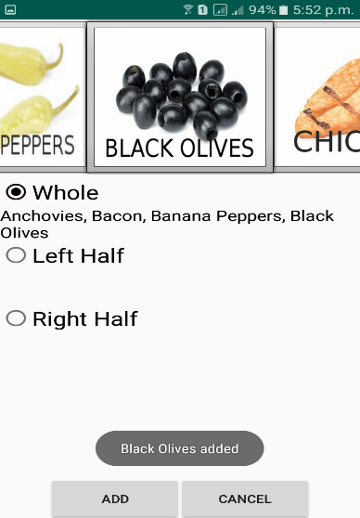
.
Pizza Toppings Selection
Toppings selection is the last phase for customizing a new pizza. After selecting the pizza size and the crust accordingly, a user needs to select the toppings in terms of whole/left half/right half (i.e. refers to how much of the pizza you want the toppings to be scattered with). Various ingredients are shown as pictures. User may choose the ingredients and procceed next by clicking add button.

Slide 21
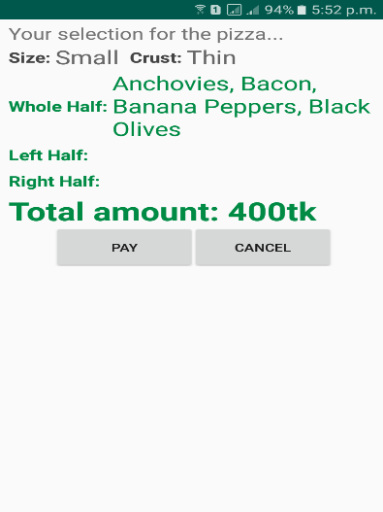
.
Pizza Info Display
Here, the user can view his selections of the pizza. The pizza size, the crust, the toppings and the total amount will be shown in this page. The user can pay with the click on the pay button or can cancel with the cancel button. Basically, in this page all the selections the user has made for creating a new pizza are displayed to the user himself.

Slide 22
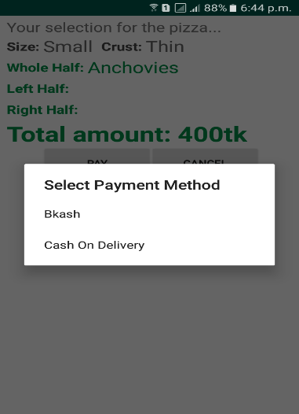
.
Payment Selection
After clicking the pay button, user can choose the payment method. Two types of payment method are added in the dialogue box . user needs to select a payment method to proceed next. “BKash” option is for making a payment through user’s own BKash number. If any user wants to pay using the cash on delivery method, then he may select “Cash On Delivery” option and it will then go to the summary page.

Slide 23
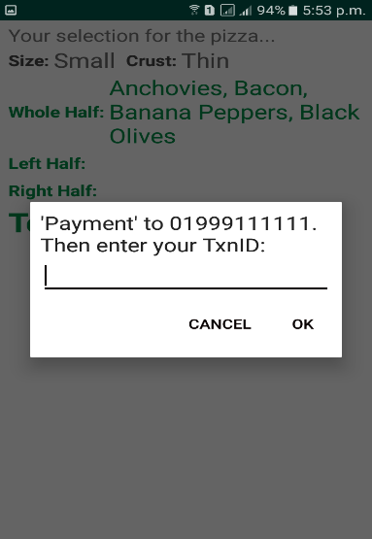
.
BKash Payment
After selecting the BKash option, a user will be displayed with a message here. The user needs to make a Payment to the given number. User needs to provide the TxnID of the Payment to make confirmation. After clicking ok, the user will go to the summary page.

Slide 24
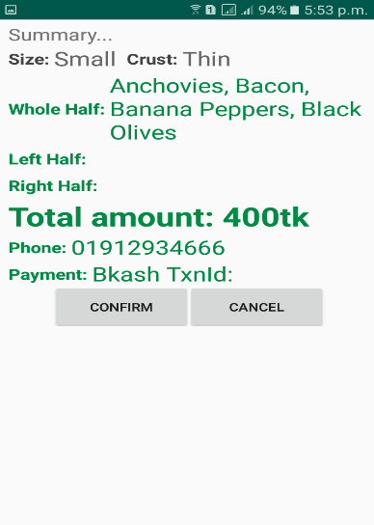
.
Summary
This is the last step to complete an order. This summary page will show the selected pizza size, the crust, the toppings, the total amount, the user’s phone number and the selected payment method with details. The user needs to check all the information for self-verification, and click the confirm button for confirming the order.

Slide 25
CONCLUSION
This was all about online pizza ordering system. Everyone may know the
importance of this system in our day-to-day lives as we all prefer online
ordering over ordering on phone.

Slide 26

END OF PRESENTATION
THANK YOU

